Slide 1
Mesh NoC
Yifu Zhou Peiliang Du
Notes:
Hello everyone
when people are designing a so call accelerator, what they usually think about is that how to achieve higher performance, while using less area and power, and these are also my design motivation. Today’s presentation, I’ll try to show you how I achieve this targets in this proposed asynchronous SNN accelerator with a mesh network on chip.

Slide 2

Outline for Reference
NoC Architecture
Processing Element
Enhancement
PE Data Flow Example
Issues & Design Modifications
Verification
Notes:
Before we start, let me give a brief introduction about the topics and contents. In the following part, I’ll talk about the overall architecture and control, followed by the microarchitecture of each functional module. verification and performance analysis of the design, and some improvement made based on the original design.
So lets start from the NoC architecture.

Slide 3
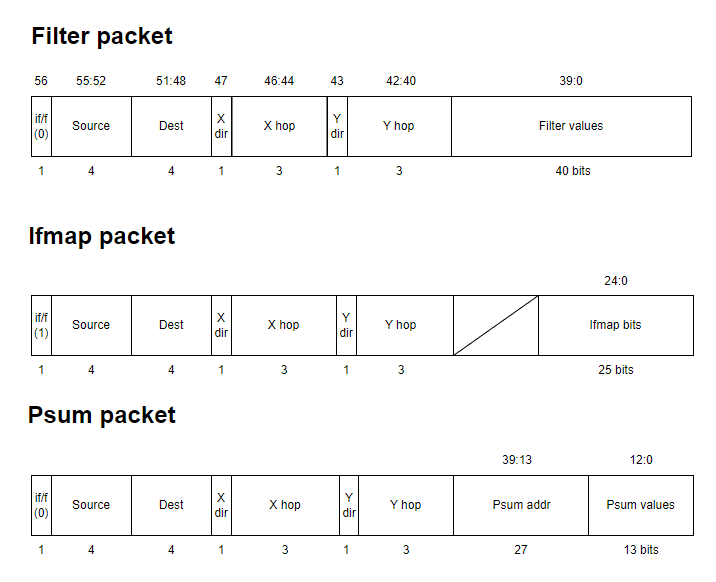
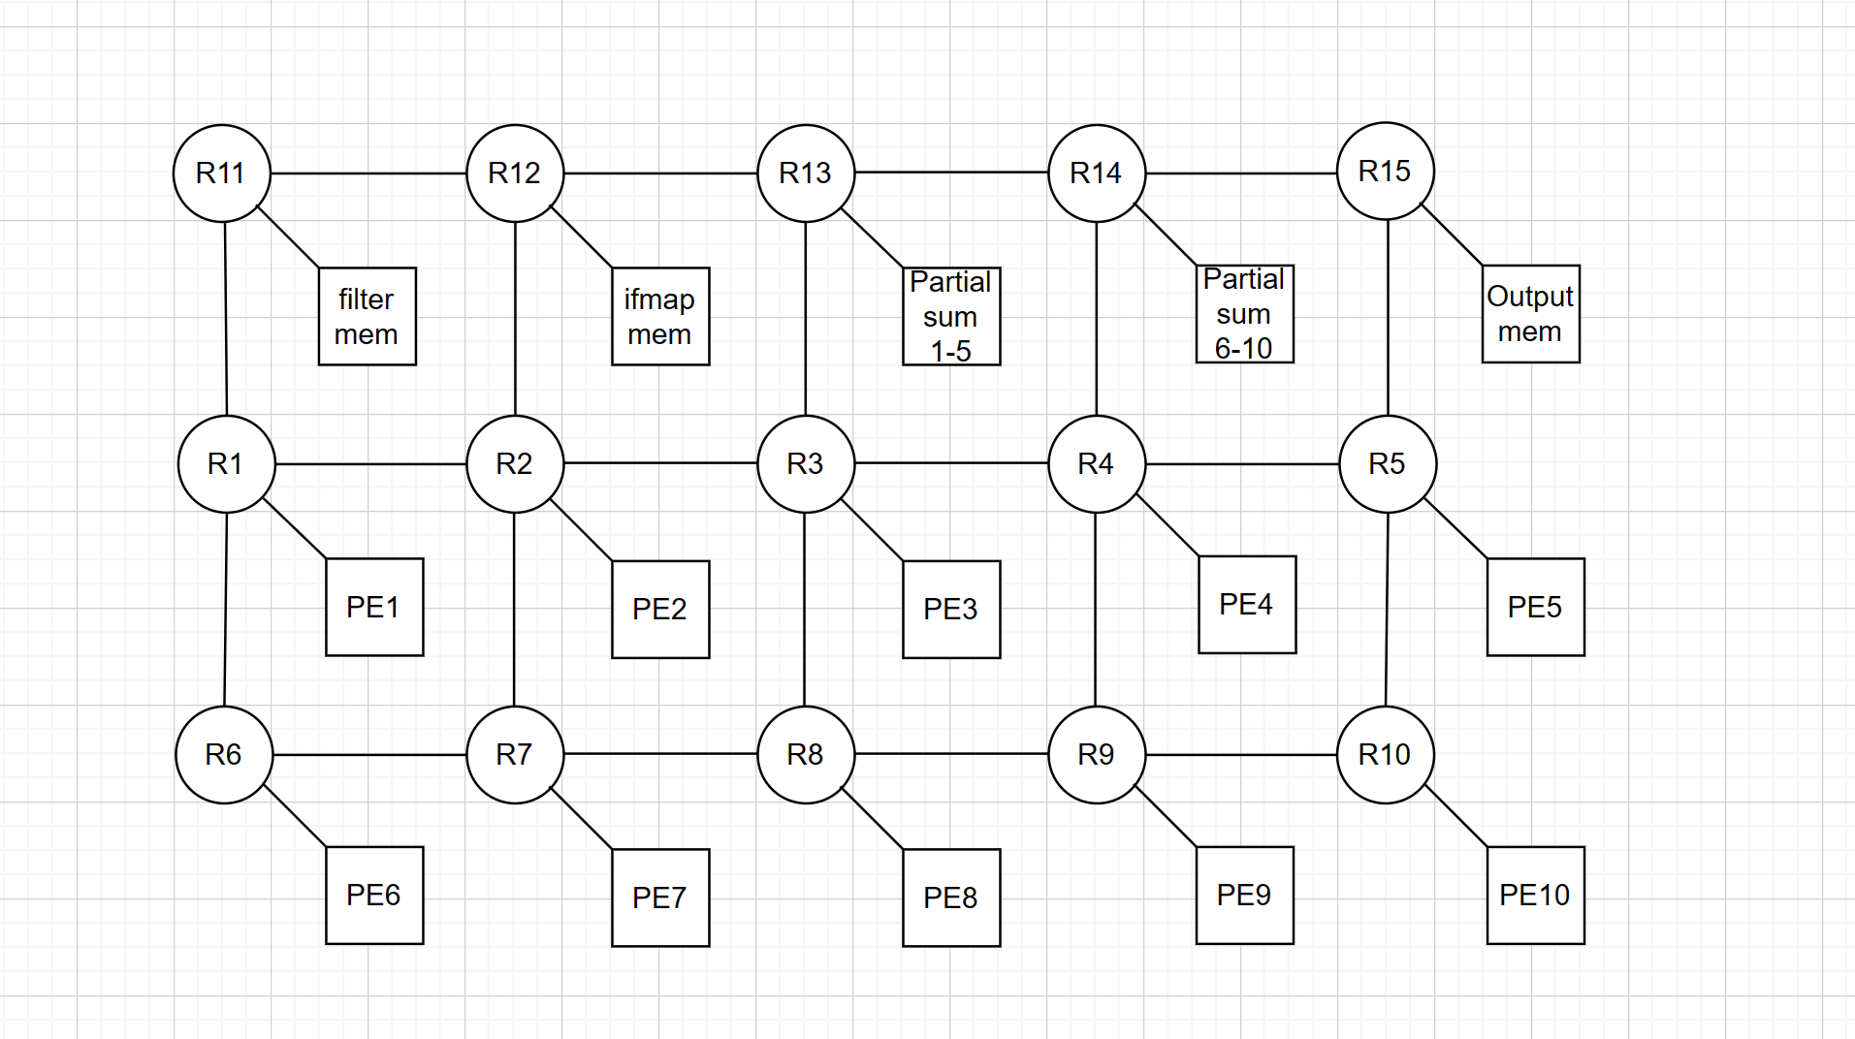
NoC Architecture
3*5 Mesh X-Y Routing
Sends 5 filter data or 25 input feature per packet
Notes:
3*5 mesh. x-y routing. data sharing minimized memory cost. 40 bit data field sends 5 filter or 25 input feature in one stroke.

Slide 4
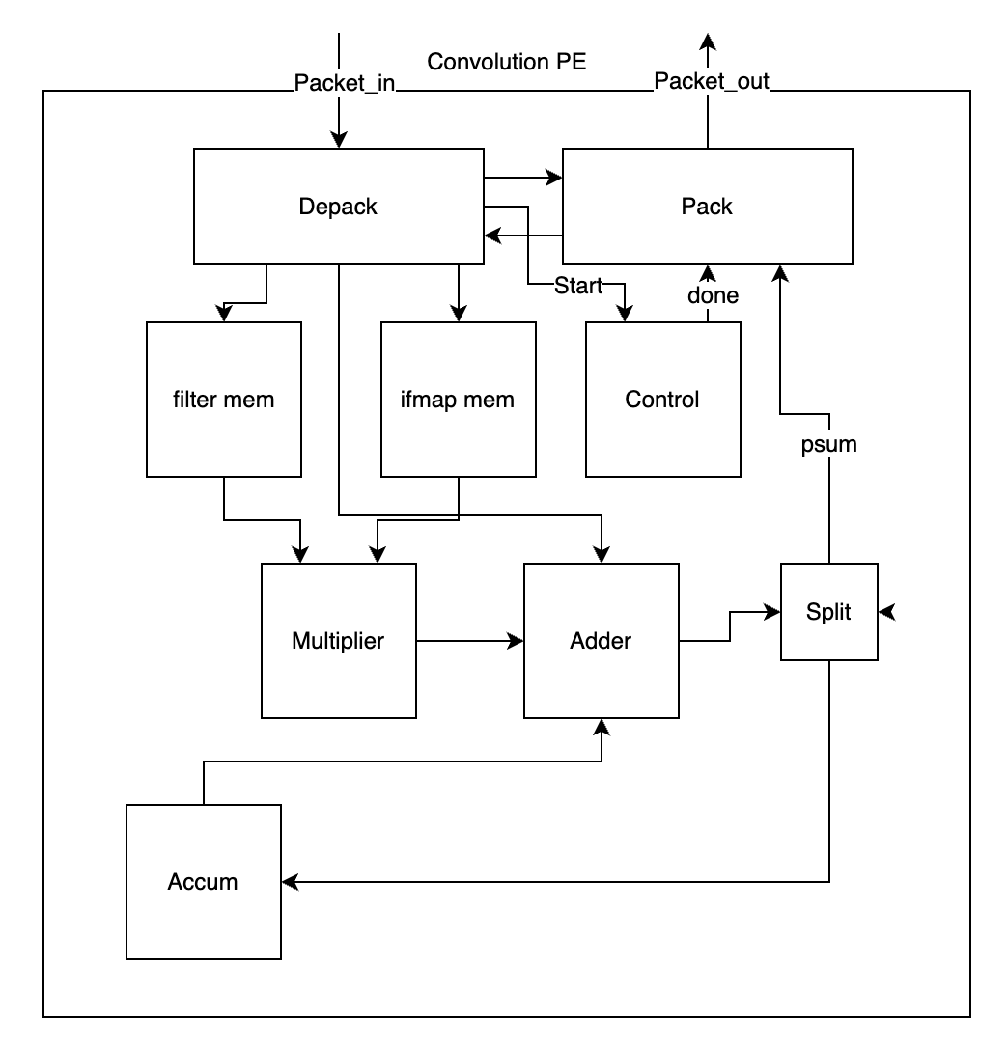
Processing Element
Two types of PE
Convolution PE
Summing PE
Convolution PE:
Receives 5 filter values
Receives 25 ifmap bits
Outputs 21 partial sums
Enhanced forwarding
Summing PE:
Receives partial sums from 5 PEs
Adds 5 partial sums each time
Sends conv outputs to output memory with corresponding addresses
Notes:
2 types of PE: Convolution PE and Summing PE
Convolution PE: Receives 5 filter values (one row), Receives 5 filter values, Outputs 21 partial sums, has state machine for enhanced forwarding
Summing PE: Adds 5 partial sums from PE each time, send conv output to mem with corresponding address

Slide 5
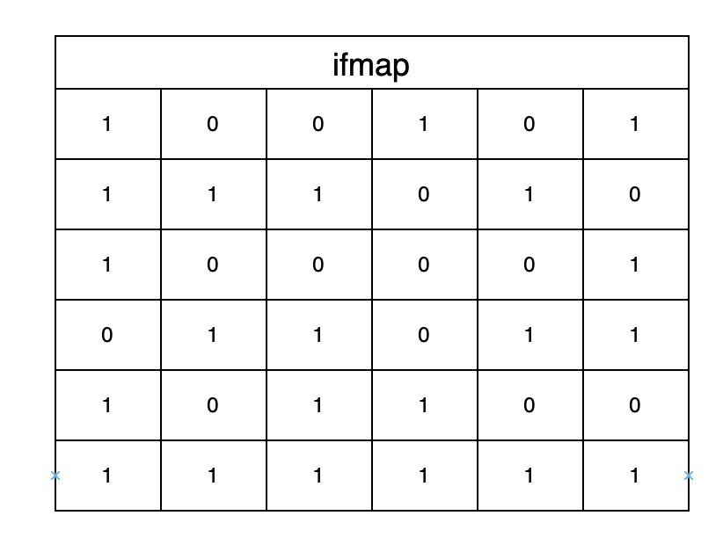
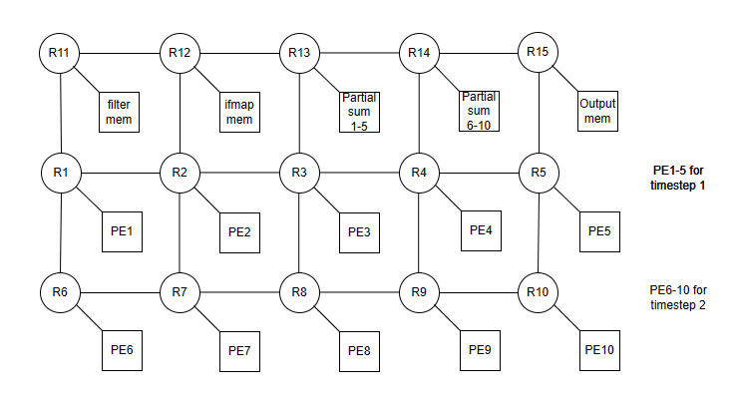
Enhancement
Basic specs
Each PE receives one row of filter
PE 1-5 for ts 1, PE 6-10 for ts 2
Filter and ifmap sharing
Only PE 5 and 10 need to receive a new row of ifmap
PE forwards ifmap and filter data
Each PE has a state machine to handle forwarding
PE mem overwrite protection
Only receives new row of ifmap when it outputs all 21 partial sums
Notes:
When calculating the new rows of the ifmap,only one new row of ifmap need to be fetched. (SHOW ANIMATION)
Then we can share filter and ifmap data between PEs.
PE1 and 6 use same row of filter.
PE1 will use the ifmap from PE2 in next calculation.
Each PE has a state machine to manage forwarding information.
For example, if PE2 forwards filter to PE7, the state machine will assign new source, dest addr, and X Y hop values

Slide 6
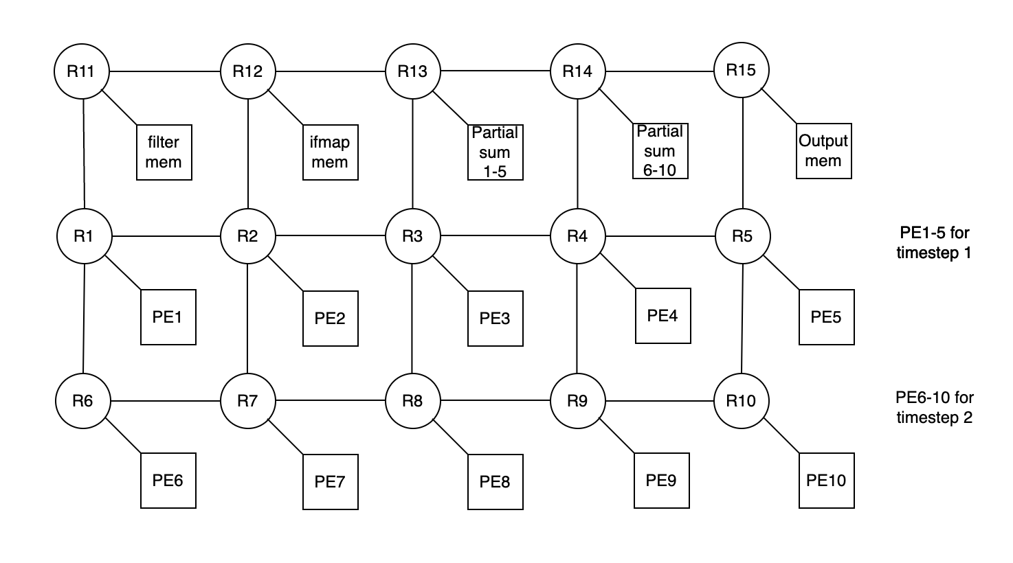
PE Data Flow Example
PE 1-5 receive filters
PE 1-5 forward filters to PE 6-10
PE 1-5 send psums to sum PE 1-5 vv.
Sum PE sends conv outputs with addrs to output mem
PE 2-5 and 7-10 forward ifmap rows to the left node
Output mem receives both conv outs for ts 1 and 2, subtracts, outputs spikes and residues
Notes:
PE 1-5 receive filters, forward the filters to 6-10, receives ifmap and send partial sum to suming PE 1-5, vice versa.
Sum PE sends outputs with addrs to output mem.
PE 2-5 and 7-10 forward ifmap rows to the left.
output mem receives conv outputs for ts 1 and 2, subtracts, and outputs spikes and residues.

Slide 7
Issues & Design Modifications
ifmap packet
residue packet
partial sum packet
Issue
sum packet arrives at Partial Sum out of order
deadlock
Temporary Solution:
Remove Partial Sum and Output Mem from NoC
Add direct channels:
Convolution PEs to Partial Sum
Partial Sum to output memory

Slide 8
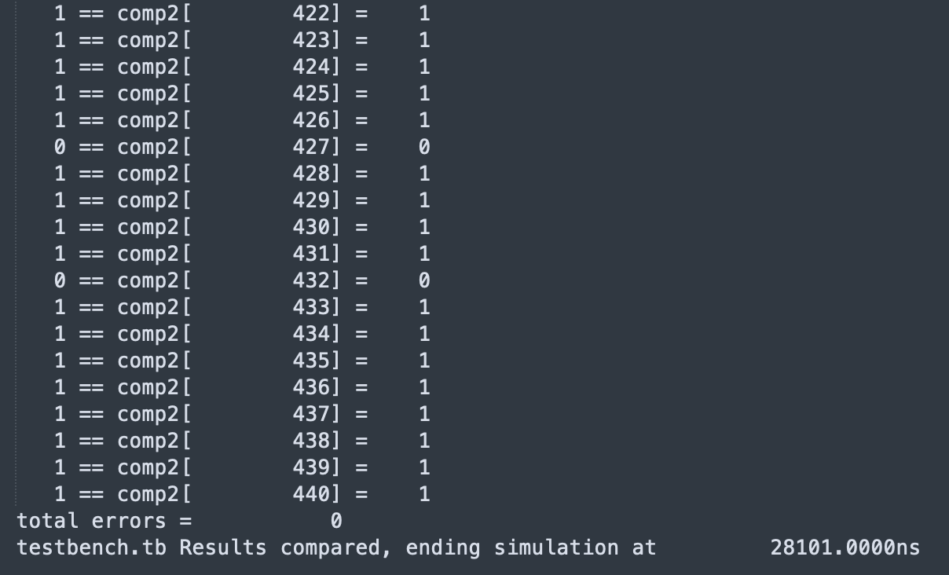
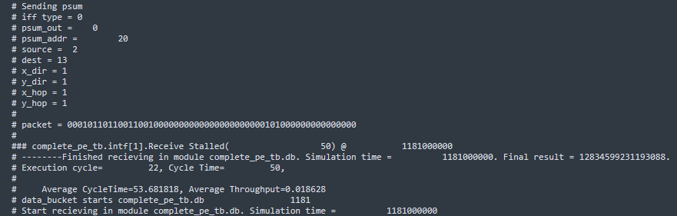
Verification
Top Level tb transcript
Convolution PE tb transcript
PE run time (one row) = 1.2 μs
top level tb passed. 0 error.
Total run time 28 μs
Notes:
Verifications were done to make sure the whole design works fine . Part of the dump file….. ….each function is operated normal. The performance of the accelerator is characterized, list in this table. The PE operating time is the time used for computing, which to a certain extent reflects the PE utilization. From the results, it can be seen that some of the processing elements waste more time to wait for the data from the memory, or partial sum from other PE, their operation must be stalled. This mean that the control flow, Although tasks are allocated to every PE, it is far from fine-grained parallelism. Some of them still need to work in collaboration. there is still room for improvement of the parallelism of each PE.

Slide 9
Thank You for Your Listening

